Slide 1
Real-time Analytical Monitoring Application
ISS – SERIS – RAM Application
Project Presentation / Iteration 0
Project Guide – Heng Boon Kui
SE-25 Part-time / Team 07
Balasubramanian Narasimhan
Kaung Myat Bo
Gao Zhiyu
Treza Bawm Win
Nay Lin Aung

Slide 2

Team Members
SE 25 Part-Time / Team 07
Kaung Myat Bo
Gao Zhiyu
Narasimhan Balaubramanian
Nay Lin Aung
Treza Bawm Win
Vincent Agnes Evangelin (Withdrawn)
Project Guide – Heng Boon Kui

Slide 3

Agenda
SERIS, our project sponsor
Project Objectives
System Overview
Project Scope
Project Team
Project Methodology
Deliverables
Project Timeline
Requirement Engineering Process & Use Case Model
Architecture and High Level Design
Project Progress & Status Update
Project Risks & Challenges
Q & A

Slide 4

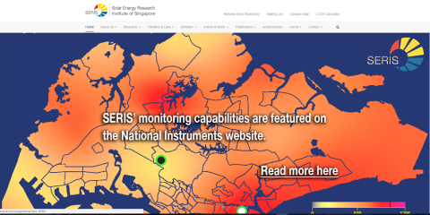
Project Sponsor
Singapore’s national institute for applied solar energy research
Is dedicated to research, development, testing and consulting on solar energy technologies and their integration into power systems and buildings
is globally active but focuses on technologies and services for tropical regions, in particular for Singapore and South-East Asia
is jointly sponsored by Singapore’s National Research Foundation (NRF) - via the Singapore Economic Development Board (EDB), and NUS
Campus located at NUS
www.seris.nus.edu.sg

Slide 5
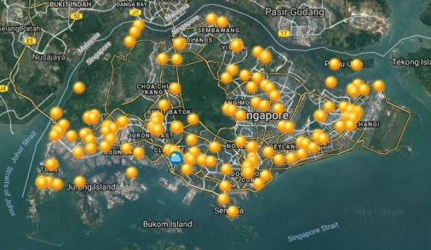
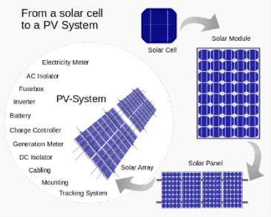

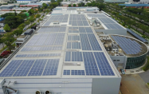


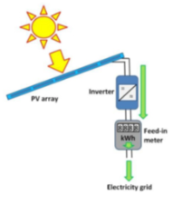
SERIS/NSR PV Systems
National Solar Repository of Singapore
PV System
Solar/Electrical Energy
Tuas
Sentosa
Changi

Slide 6

Project Objectives
Real-time Analytical Monitoring Application (RAM)
To develop a cloud based platform for integrating and managing real-time analytical monitoring of PV systems performance
RAM will support monitoring of PV systems – from small rooftop systems to large ground-based PV power plants in the multi-MW range across different climate zones
Web portal – A web portal for users to access the application components,
Data Engineering – A cloud based application that can record, transform and report the data sent from PV systems,
SERIS Interface – An interface between the application and SERIS central monitoring system which.

Slide 7





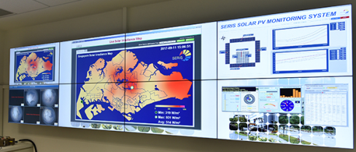


RAM Application Overview
PV System(s)
Central Data Engineering
RAM Web Portal
IoT Sensors
(Temp, Light, Current, Voltage.,)
Alerts
Browser Interface
SERIS Interface(Ext)
App Users

Slide 8

RAM Overview
A Web portal – A web portal for users to access the application components
User Management
Device and Station configurations
Report configuration
Central Data Engineering – A cloud based application that can record, transform and report the data sent from PV systems.
Data Capture – Cloud based components that captures and records the incoming data (unstructured) sent from sensors
Transformation – Cloud based components that transform and records the unstructured data into structured data for further analytics and reporting purposes
Reporting – Cloud based reporting component that performs back-end analytical calculations and make it available for both front-end reporting and as well as for interfacing with SERIS’s in-house central monitoring system
Alter/Notification – An alert to be sent in case of device failures, which can be pre-configured in the application
An interface to SERIS – The interface between the application and SERIS central monitoring system. This interface enables communication and interaction between the proposed application and the SERIS Central Monitoring system

Slide 9

Benefits
A single centralized platform for users to process the structured data from remote stations
Automated data capture for the un-structured, structured and semi structured parameters
Transformation of unstructured data into structured data
Analytical reporting of the stations and devices
Interface with other backend systems within the organization, in this case integration with SERIS central monitoring system
Audit trail capability of the incoming data

Slide 10

Characteristics
RAM to be built on Cloud technology to offer high degrees of agility and the ability to collect high volumes of data in real time
RAM allows PV system device(s) to generate very high volumes of unstructured data, from a variety of devices and store it in Cloud Database
RAM allows admins to configure and incorporate cloud-based system to reduce the cost of maintaining servers, to avoid data losses and to simultaneously access the system from multiple internet connected devices (computer, tablet, mobile phone)
Users will access and use the application via browser interface

Slide 11

Project Scope
Central Data Engineering – A cloud based application that can record, transform and report the data sent from PV systems.
Data Capture – Cloud based components that captures and records the incoming data (unstructured) sent from sensors
Transformation – Cloud based components that transform and records the unstructured data into structured data for further analytics and reporting purposes
Reporting – Cloud based reporting component that performs back-end analytical calculations and make it available for both front-end reporting and as well as for interfacing with SERIS’s in-house central monitoring system
Alter/Notification – An alert to be sent in case of device failures, which can be pre-configured in the application
A Web portal – A web portal for users to access the application components
User Management
Device and Station configurations
Report configuration
An interface to SERIS – The interface between the application and SERIS central monitoring system. This interface enables communication and interaction between the proposed application and the SERIS Central Monitoring system

Slide 12


Project Scope – Administration
System Administration Functions
System Setup
System Configuration Management
App Server, Database Server, .,
Application Administration Functions
User Management
User/Access Control Mapping
Device Management
Device Group Management
Station Management
Persona Management

Slide 13
Project Scope – Central Data Engineering
Data Capture
Captures and records incoming data (unstructured data) sent from IoT sensors
Capturing Device Health status sent by devices
Data Transformation
Transforms and records the unstructured data into structured data for further analytics and reporting purposes
Performs back-end analytical calculations and make it available for both front-end reporting and as well as for interfacing with SERIS’s in-house central monitoring system
Reporting
The structured data should be available and accessible by users in the form of reports, charts, and graphs
The raw/un-structured data should be available and accessible by users, and they will be given an option to download the raw data
Alerts/Notification – Send alerts to users in case of device failures

Slide 14
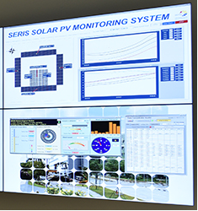
Project Scope – Web portal & SERIS Interface
Web portal
Browser Interface – Users access the application’s web-portal via a standard browser interface with an active internet connection
User login and Access control mapping – The system allows authorised user(s) to access the application. After authentication user will have access to main menu. Availability of menu functions depends on user’s level of access.
SERIS Interface
The interface between the application and SERIS central monitoring system. This interface enables communication and interaction between the proposed application and the SERIS Central Monitoring system

Slide 15

Project Team Structure
SERIS
Head of Solar System Technology Group (Dr.Zhao Lu)
ISS
Project Guide (Heng Boon Kui)
Project Manager
SERIS
Technical Specialist (Soe Pyae)
SE 25 – PT 07
Responsibility | Name
Project Manager | Kaung Myat Bo
Project Liaison | Kaung Myat Bo
System Architect | Treza Bawm Win
Quality Manager | Nay Lin Aung
Technical Leader | Gao Zhiyu
System Analyst | Vincent Agnes Evangelin
Change Manager | Balasubramanian Narasimhan
Developers/Software Engineers/Testers | Kaung Myat Bo, Nay Lin Aung, Treza Bawm Win, Gao Zhiyu, Vincent Agnes Evangelin, Balasubramanian Narasimhan
Quality Assurance Manager
System Architect
System Analyst
Lead Developer
Change Manager
Software Testers
Software Engineers

Slide 16
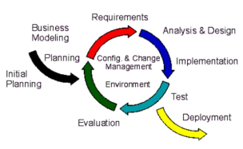
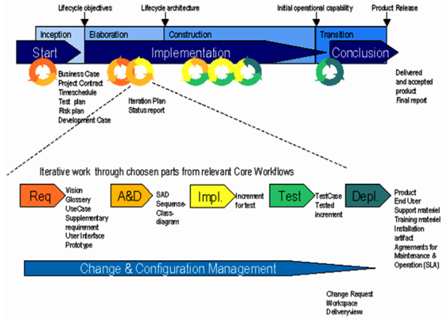
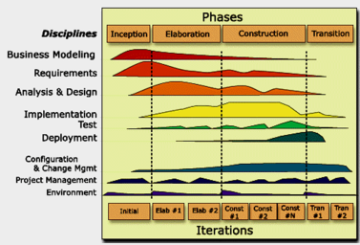
Project Methodology – RUP and Iterative Dev.
RUP – Rational Unified Process
A well defined SE Process; Static dim(organized into workflows, activities, process disciplines, artefacts and roles) & Dynamic dim(Time)
RUP and Iterative Development
Planning & Feasibility
Increment 1 & 2

Slide 17
Deliverables and Increments
Planning & Feasibility Phase | Increment 1 Development Phase | Increment 2 Development Phase
Project Plan Quality Plan User Requirements Specification (URS) Use Case Model Survey (UCMS) Prototyping Study Report High-Level Design Spec | Requirements Model Report High-Level Design Spec(revised) Design Model Report System Test Documentation Acceptance Test Documentation Project Plan (revised) User Guide | Requirements Model Report (finalized) High-Level Design Spec(finalized) Design Model Report (finalized) System Test Doc (finalized) Acceptance Test Doc (finalized) User Guide (finalized) Final System End of Project Report

Slide 18
Management Deliverables
File Category | File Reference | File Description
Project Communication | SE25PT7SERIS/SERIS/MGMT/MEETING/EC SE25PT7SERIS/SERIS/MGMT/MEETING/ /IC SE25PT7SERIS/SERIS/MGMT/MEETING/AUM SE25PT7SERIS/SERIS/MGMT/PLAN/WIF | External Correspondence Internal Correspondence Audit Minutes Work Instruction Forms
Plans | SE25PT7SERIS/SERIS/MGMT/PLAN/PP SE25PT7SERIS/SERIS/MGMT/QUALITY/MTP SE25PT7SERIS/SERIS/MGMT/QUALITY/UTP SE25PT7SERIS/SERIS/MGMT/QUALITY/STP SE25PT7SERIS/SERIS/MGMT/QUALITY/ATP | Project Plan Master Test Plan Module/Unit Test Plan System Test Plan Acceptance Test Plan
Quality | SE25PT7SERIS/SERIS//MGMT/QUALITY/QP SE25PT7SERIS/SERIS/MGMT/QUALITY/PFP SE25PT7SERIS/SERIS/MGMT/QUALITY/CP | Quality Assurance Plan Project Procedures Configuration Procedures
Reporting and Progress Control | SE25PT7SERIS/SERIS/MGMT/PLAN/TR SE25PT7SERIS/SERIS/MGMT/PLAN/PR | Time Reports Progress Reports

Slide 19
Technical Deliverables
File Category | File Reference | File Description
Work Files | SE25PT7SERIS/SERIS/TECH/TWORK/KMB SE25PT7SERIS/SERIS/TECH/TWORK/NAYLA SE25PT7SERIS/SERIS/TECH/TWORK/TREZA SE25PT7SERIS/SERIS/TECH/TWORK/GAOZY SE25PT7SERIS/SERIS/TECH/TWORK/BALA SE25PT7SERIS/SERIS/TECH/TEST/UT SE25PT7SERIS/SERIS/TECH/TEST/ST SE25PT7SERIS/SERIS/TECH/TEST/UAT | Kaung’s Workfile Nay’sWorkfile Treza’s Workfile Gao’sWorkfile Bala’sWorkfile Module/Unit Testing Workfile System Testing Workfile Acceptance Testing Workfile
Technical Specifications | SE25PT7SERIS/SERIS/SPEC/REQUIREMENT/URS SE25PT7SERIS/SERIS/SPEC/REQUIREMENT/UIS SE25PT7SERIS/SERIS/TECH/DESIGN/HLD SE25PT7SERIS/SERIS/TECH/USER/API SE25PT7SERIS/SERIS/TECH/DEPLOY/DPC | User Requirement Spec User Interface Spec High Level Design Specification Programmer’s Manual Deployment Document
User Documents | SE25PT7SERIS/SERIS/TECH/USER/UG | User’s Manual
Software Configuration Management | SE25PT7SERIS/SERIS/TECH/LOGS/TC.1 SE25PT7SERIS/SERIS/TECH/LOGS/TC.2 SE25PT7SERIS/SERIS/TECH LOGS/TC.3 SE25PT7SERIS/SERIS/TECH/LOGS/TC.4 | Observation Reports/Error Log Change Record in Change Log Testing & Verification Log Configuration Log of all versions

Slide 20
Deliverables – Increment 0
Planning & Feasibility Phase
Project Plan Quality Plan User Requirements Specification (URS) Use Case Model Survey (UCMS) Prototyping Study Report High-Level Design Spec

Slide 21
Project Timeline
Phase / Timeline | Jan 2018 | Feb | Mar | Apr | May | Jun | Jul | Aug | Sep | Oct | Nov | Dec 2018 | Jan 2019
Increment 0 |  |  |  | 7
Increment 1
Increment 2
Initial Planning
Requirements Engineering
Requirements Analysis
Analysis and Design
Dev. (Env. Setup & Coding)
SIT
*Training & UAT
SAD
2 - May
Development
SIT
UAT
#
@
*Training – Train the trainer # – Training @ – Handover
21

Slide 22
Project Effort Estimation
Use Case Point Estimation
Unadjusted Use Case Point (UUCP) | Total Weight (Actors + UseCases) 16 (actors) + 130 (use cases) 146
Use Case Point (UCP) | UUCP x TCF x EF 146 * 1.02 * 0.89 132.54
Effort (man days) | UCP x ISS_Productivity_Factor 132.54 * 17 2,253 man hours; i.e. 282 man days
TCF – Technical Complexity Factors →1.02 EF – Environmental Factors → 0.89

Slide 23
Requirement Engineering Process
Face to face meeting and team discussion (Requirement Workshops)
Understand the current Business Process, Business Requirements
Conducting research on other existing PV monitoring solutions, including SERIS
Prepare the User Requirement Specification
Prepare URS to comply with business process
Verify the URS with the Client
Discuss the proposed solution and validate the Requirement and Business Rules
Prototype Study
We evaluated tech stack using AWS IoT landscape
Work in progress for some components
Notes:
FRD Review - During the meeting, the requirements are quickly scanned, and discussion takes place on any requirement where attendees have questions or concerns. After a quick discussion, the requirement is modified or left alone.

Slide 24
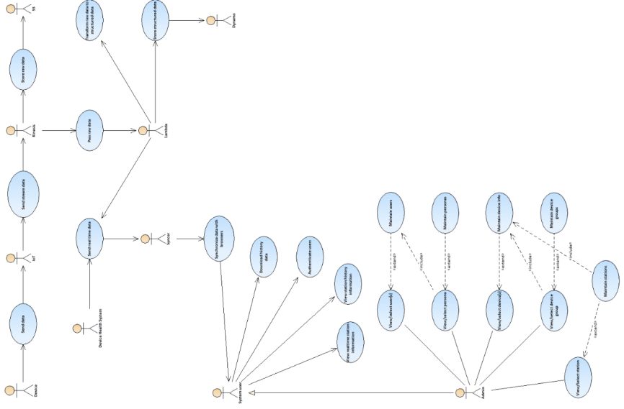
Use Case Model (Primary Use Case - Overview)

Slide 25
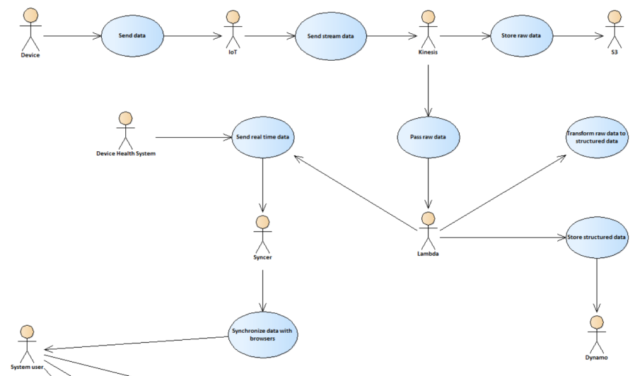
Use Case Model (Primary Use Case 1 of 3)
Receiving incoming data, lambda streaming real-time data & streaming device health status

Slide 26
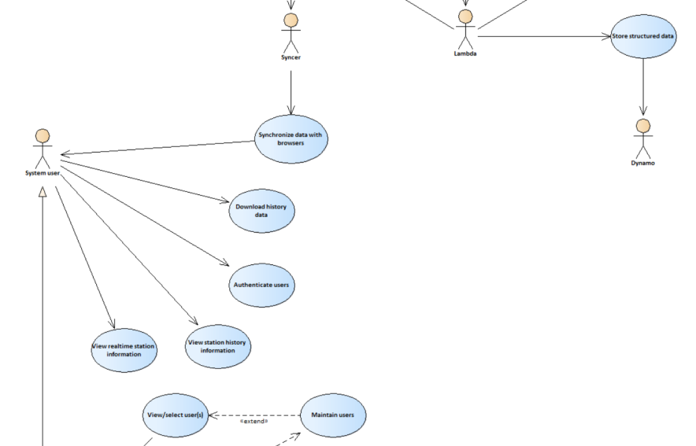
Use Case Model (Primary Use Case 2 of 3)
Ordinary User – Use Case

Slide 27
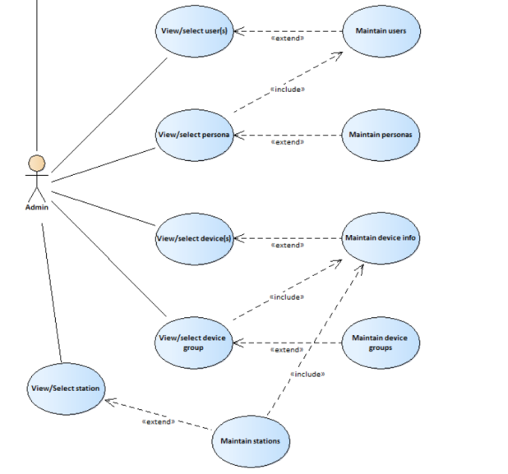
Use Case Model (Primary Use Case 3 of 3)
Administrator – Use Case

Slide 28
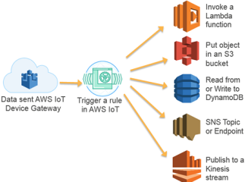
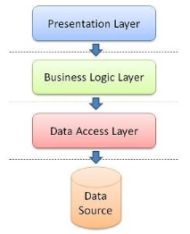

Architecture & Technologies Used
AWS IoT Landscape
AWS Lambda
Dynamo DB
AWS S3
AWS Kinesis
AWS Containers
Backend Web-Service API
Front-end web application
Chart Libraries

Slide 29
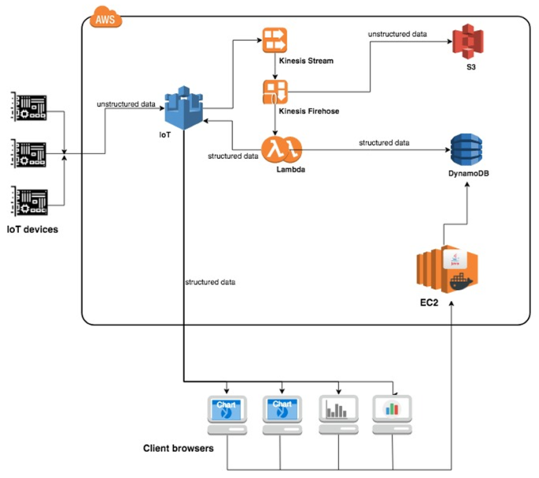
High Level Design

Slide 30
Prototype
Phase – I
Windows acting as a device (Simulation)
Sending data to IoT Core
Subscribe to MQTT topic
Extract and Display the transmitted msg
Configure rules in AWS IoT to Trigger lambda fn()
Invoke a lambda function
Message Persistence in dynamoDB
Stores these messages into dynamoDB
Phase – II
lambda sends message back to IoT core
IoT core captures the message sent by lambda

Slide 31
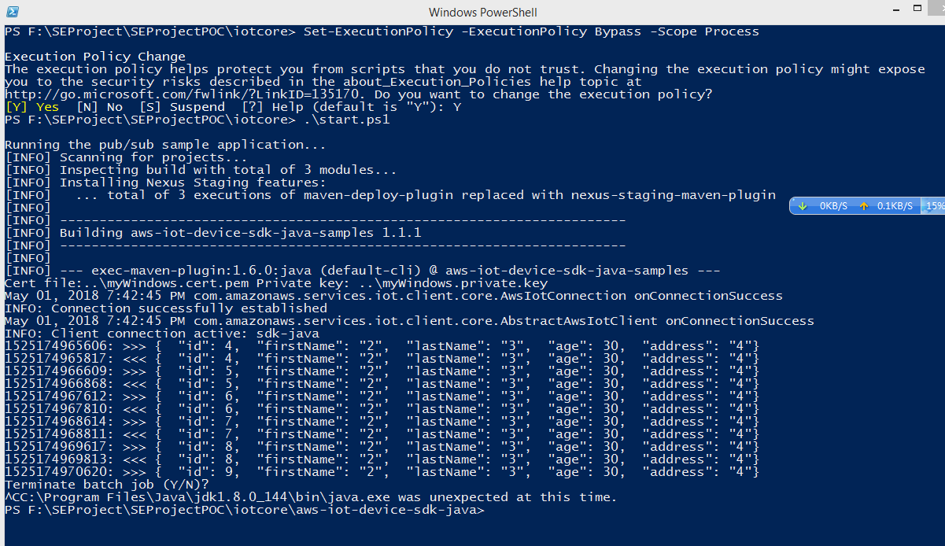
Windows acting as a device (Simulation)
Sending data to IoT Core

Slide 32
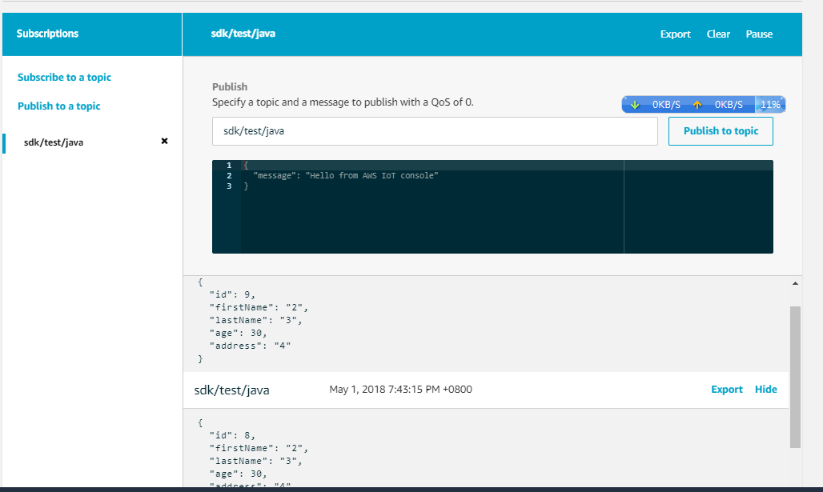
Subscription to MQTT topic
Extract and Display the transmitted msg

Slide 33
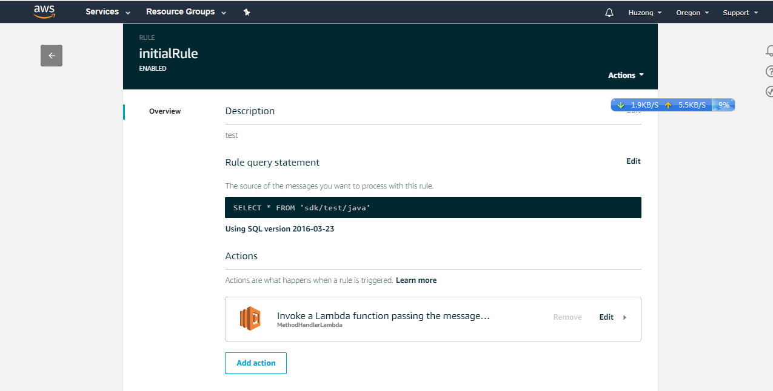
Configure rules in AWS IoT to trigger lambda fn()
Invoke a lambda function

Slide 34
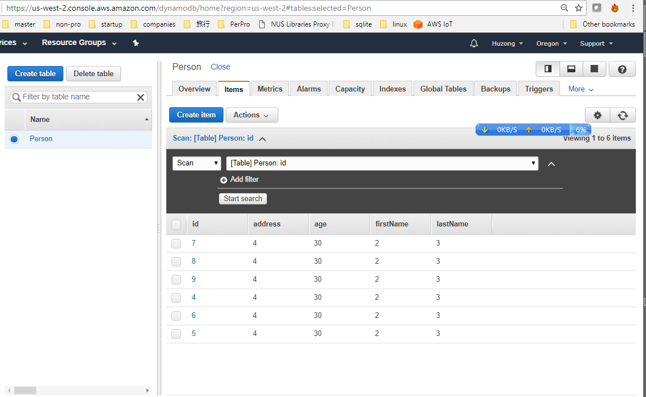
Message Persistence in dynamoDB
Store these messages into dynamoDB

Slide 35
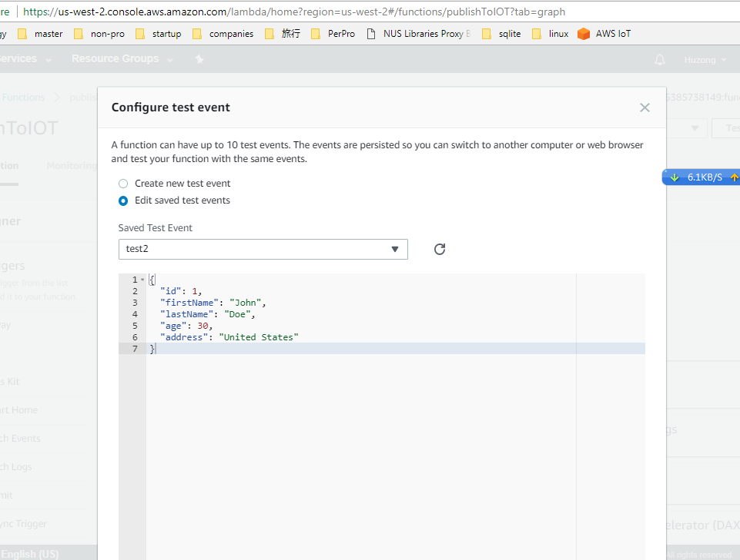
Phase-2: lambda sends message back to IoT core
Lambda sends msg back to IoT core

Slide 36
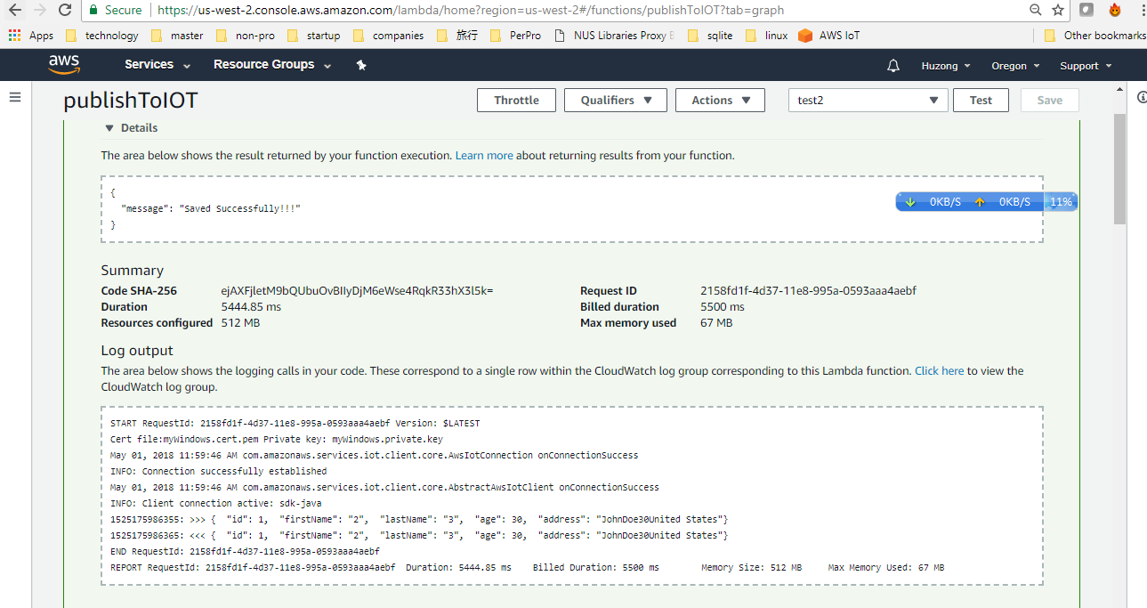
lambda execution…
lambda execution…

Slide 37
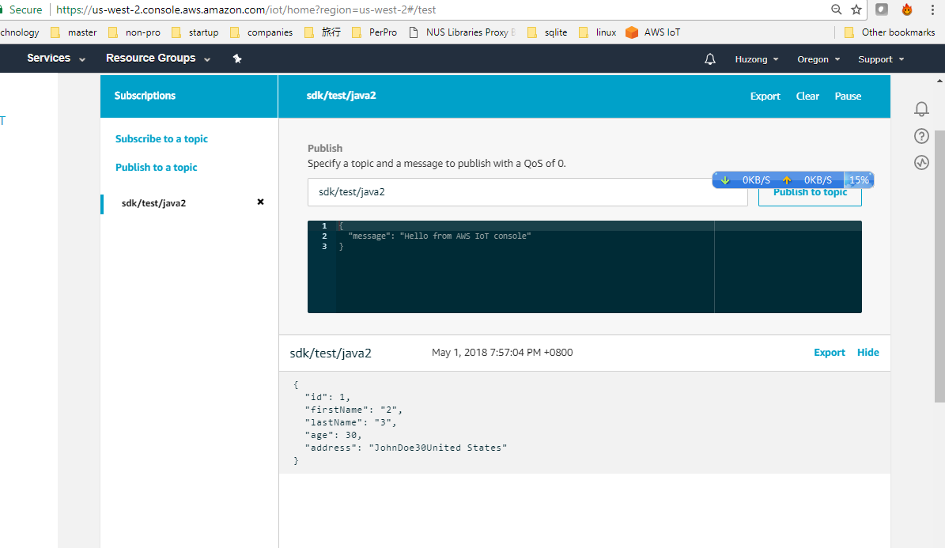
IoT core captures the msg sent by lambda
IoT core receiving msg’s from lambda

Slide 38


Q & A

Slide 39





Thank you
What’s Your Message?

Slide 40
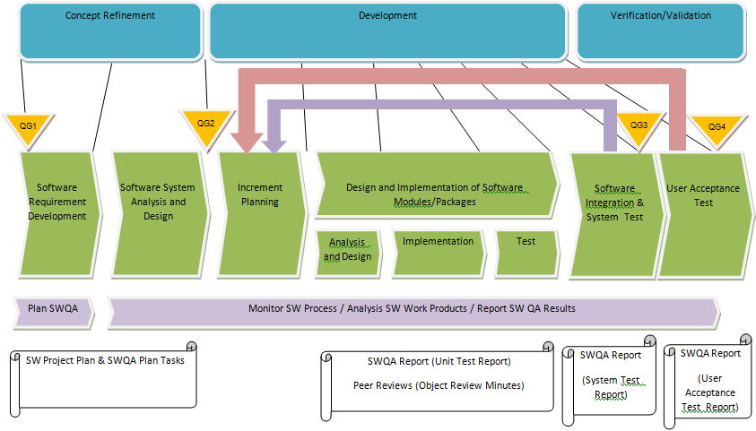
Quality Management Process

Slide 41
Software Testing
Module Test/Unit Test
Module or Package level/unit test will be performed.
Functionality check will be performed according to specifications and it has to fulfil
respective package/module’s requirements.
Integration and System Test
Integration test is next level after having successfully finished module/unit test.
This test is to check interfaces between respective modules when integrating each module.
communication between modules, their functionalities and interactions must be checked.
Software System Test is the next level after having successfully finished the integration test.
The purpose of the Software System Test is to test the integrated software that will satisfy the software
requirements. The focus is the functionality of the software system. The software system test has to be
performed.
To complete the Software System Test, test must be performed based on Test Cases derived from
customer requirements.
User Acceptance Test
This test basically needs to fulfil user requirements and prove that the software system works according
to its requirement specifications.
Together with customer ,user acceptance test will be carried out to verify that agreed user requirements are
met and get customer’s approval.

Slide 42
Software Testing (Cont.)
Customer Required Tests
Special tests required by the customer to verify specific issues.
Often the test specifications for these tests are written by the customer, refer them in related documents.
Regression Test
Consider regression testing (renewed testing in the future changes to verify that modifications have not caused unintended effects and that the software still complies with the requirements):
Reuse all test information as much as possible.
Due to budget, time and resource limitations, it is often necessary to define a strategy for selecting an adequate subset of tests for retesting.
It is always necessary to check the test specification if
new test cases have to be defined
existing test cases have to be modified
existing test cases have to be added
to ensure an adequate test coverage. After major changes , it is necessary to check the test plan as well.
Define a suitable regression test strategy considering the different test levels. Use the test case priorities to define an appropriate regression test scope . Ensure that at least all priority 1 test cases have to be executed
for one regression test cycle.

Slide 43
Management Deliverables
File Category | File Reference | File Description
Project Communication | SE25PT7SERIS/SERIS/MGMT/MEETING/EC SE25PT7SERIS/SERIS/MGMT/MEETING/ /IC SE25PT7SERIS/SERIS/MGMT/MEETING/AUM SE25PT7SERIS/SERIS/MGMT/PLAN/WIF | External Correspondence Internal Correspondence Audit Minutes Work Instruction Forms
Plans | SE25PT7SERIS/SERIS/MGMT/PLAN/PP SE25PT7SERIS/SERIS/MGMT/QUALITY/MTP SE25PT7SERIS/SERIS/MGMT/QUALITY/UTP SE25PT7SERIS/SERIS/MGMT/QUALITY/STP SE25PT7SERIS/SERIS/MGMT/QUALITY/ATP | Project Plan Master Test Plan Module/Unit Test Plan System Test Plan Acceptance Test Plan
Quality | SE25PT7SERIS/SERIS//MGMT/QUALITY/QP SE25PT7SERIS/SERIS/MGMT/QUALITY/PFP SE25PT7SERIS/SERIS/MGMT/QUALITY/CP | Quality Assurance Plan Project Procedures Configuration Procedures
Reporting and Progress Control | SE25PT7SERIS/SERIS/MGMT/PLAN/TR SE25PT7SERIS/SERIS/MGMT/PLAN/PR | Time Reports Progress Reports

Slide 44
Technical Deliverables
File Category | File Reference | File Description
Work Files | SE25PT7SERIS/SERIS/TECH/TWORK/KMB SE25PT7SERIS/SERIS/TECH/TWORK/NAYLA SE25PT7SERIS/SERIS/TECH/TWORK/TREZA SE25PT7SERIS/SERIS/TECH/TWORK/GAOZY SE25PT7SERIS/SERIS/TECH/TWORK/BALA SE25PT7SERIS/SERIS/TECH/TEST/UT SE25PT7SERIS/SERIS/TECH/TEST/ST SE25PT7SERIS/SERIS/TECH/TEST/UAT | Kaung’s Workfile Nay’sWorkfile Treza’s Workfile Gao’sWorkfile Bala’sWorkfile Module/Unit Testing Workfile System Testing Workfile Acceptance Testing Workfile
Technical Specifications | SE25PT7SERIS/SERIS/SPEC/REQUIREMENT/URS SE25PT7SERIS/SERIS/SPEC/REQUIREMENT/UIS SE25PT7SERIS/SERIS/TECH/DESIGN/HLD SE25PT7SERIS/SERIS/TECH/USER/API SE25PT7SERIS/SERIS/TECH/DEPLOY/DPC | User Requirement Spec User Interface Spec High Level Design Specification Programmer’s Manual Deployment Document
User Documents | SE25PT7SERIS/SERIS/TECH/USER/UG | User’s Manual
Software Configuration Management | SE25PT7SERIS/SERIS/TECH/LOGS/TC.1 SE25PT7SERIS/SERIS/TECH/LOGS/TC.2 SE25PT7SERIS/SERIS/TECH LOGS/TC.3 SE25PT7SERIS/SERIS/TECH/LOGS/TC.4 | Observation Reports/Error Log Change Record in Change Log Testing & Verification Log Configuration Log of all versions

Slide 45
Q & A

Slide 46
Thank you
What’s Your Message?

Slide 47
Agenda – ISS Expectation (Hidden Slide)
Introduction to the project (project background etc).
Overview of the user requirements including presentation of the use case model.
Discussion of project risks and technical challenges.
Discussion of your overall project strategies (both management and technical) including your incremental development strategy. In particular, you should clearly show the use cases to be realized in each increment.
Discussion of your software architecture, including demonstration of your prototype of architecturally significant use cases to show the feasibility of your architecture and to address technical challenges etc.
Presentation of your projects plans, including estimates and schedule. Your presentation should include a justification for your effort estimates.
Report on overall project progress so far against the plans (planned versus actuals), including a discussion of reasons for differences (if any).
Discussion of management problems that may have occurred during this first phase of the project (such as the need to de-scope, loss of man-power, falling behind schedule etc), including a description of your solutions.
When considering the content to be presented, do take note of the following:
Wherever applicable in the above items to be presented, do emphasize your added value by highlighting the use of novel/innovative management/technical techniques/approaches/considerations in dealing with challenges/issues that were encountered/anticipated. Do also highlight efforts where your team goes beyond what is normally expected of.
If your process varies from the regular incremental model, do make the necessary adjustment so that the presented content suitably reflects your progress and achievement.

Slide 48
Project Progress
X
Y

Slide 49
Work status
X
Y

Slide 50
Risk Item | Control type | Specific Detail
Project team member turnover | Schedule slippage and increased cost | N/A
Late response from client | Schedule slippage | shares the project schedule to client and mention the latest expected feedback
Late change in requirement spec from client | Schedule slippage and increased cost | Regular meetings with client to clarify requirements
Issue during system integration with external system | Schedule slippage and increased cost | Intensive study will be done
Delayed decision on payment vendor selection | Schedule slippage and increased cost | Intensive study will be done
Project team is not familiar with technology requested by client | Performance issue and increased cost | Training plan is created
Issue with software versioning and revision control | Schedule slippage | Synchronize working document among project team regularly
Technology Challenges
Developing hybrid application using React Native, React Native community is small for any support or help
FCM and other queuing techniques are new to the team

Slide 51
xxx
X
Y

Slide 52
Problems Encountered & Resolution
Synapse direct involvement on deciding on tech scope, restricting the tech scope by various technical workshops
Social Dining scope, initial scope was not defined, various Requirement Analysis meeting with user to finalise and baselining URS
Payment vendor finalisation, team went ahead to evaluate payment options like Singapay and suggesting SingTel Dash payment

